Slide 1


SILVER
LINING
Aaron Cranor
Stephen Martinez
Darcy DeBord
Notes:
Initial goal: Develop a model to detect mental health support needs using Twitter data
Pivot: Shifted to sentiment analysis of Google reviews due to limited training data
Enhanced scope: Automated professional response generation using Claude API

Slide 2


STATISTICS
90%
90% of potential customers always read at least one review before visiting a business ​
Notes:
It may appear that it doesn’t impact your business, but think again. If you operate an online business, maintaining a Google ID is crucial for staying competitive.​
Google, as the world’s leading search engine, plays a pivotal role in your online visibility. Your ranking can significantly influence your business’s success and online presence. Garnering positive reviews on Google not only boosts your visibility but also enhances your return on investment (ROI).​

Slide 3





USE CASES
Monitor and address both positive and negative feedback​ and quickly analyze and respond to reviews
Gain understanding of customer sentiments and common issues
Help customer service representatives craft appropriate responses​
REPUTATION MANAGEMENT
BUSINESS INSIGHT
TRAINING TOOL
Notes:
Our solution offers a range of use cases to enhance business operations. In Customer Service, it enables quick analysis and response to customer reviews, ensuring timely and effective interactions. For Reputation Management, it provides tools to monitor and address both positive and negative feedback, helping maintain a strong brand image. By offering Business Insights, our solution allows businesses to understand customer sentiments and identify common issues, driving informed decision-making. Additionally, as a Training Tool, it supports customer service representatives in crafting appropriate responses, leading to improved communication and customer satisfaction.

Slide 4

01
02
03
04
05
INPUT
PREDICT
ANALYZE
COMPARE
GENERATE
User inputs Google Review
LSTM model predicts sentiment
Claude AI analyzes the review and generates a response​
The system compares LSTM and Claude sentiments​
The final output displays the agreement status and the generated response​

Slide 5






REQUIREMENTS
Gradio
Python
Anthropic API
Langchain
TensorFlow

Slide 6

FEATURES
Sentiment analysis of Google reviews using a pre-trained LSTM
User-friendly interface with Gradio​
SENTIMENT
INTERFACE
Comparison of LSTM and Claude sentiment analysis results​
AI-powered response generation using Claude 3.5 Sonnet​
GENERATION
COMPARISON
Notes:
Model Development
Data Processing
Training Process
Model Evaluation

Slide 7
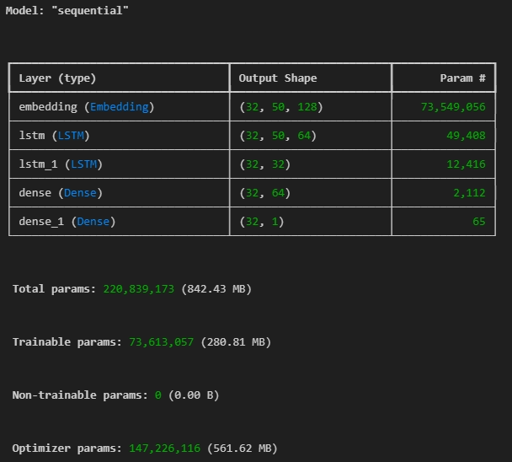
MODEL SUMMARY

Slide 8

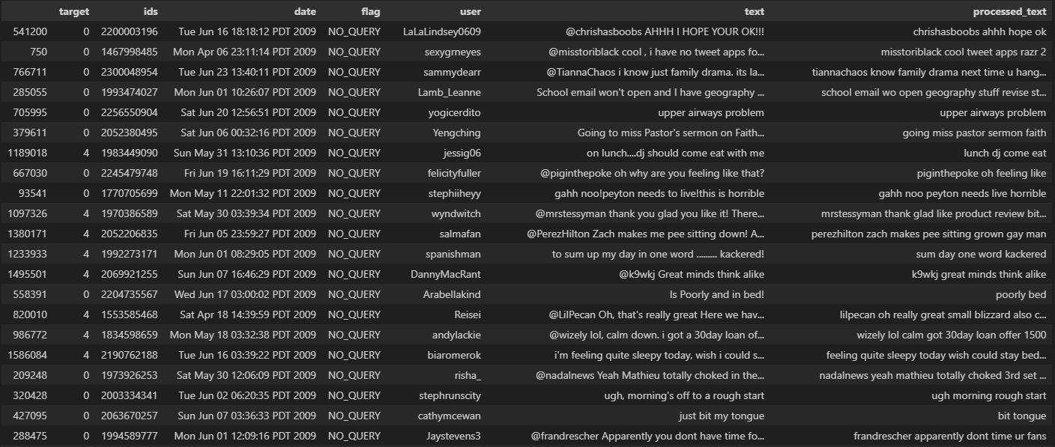
PRE PROCESSING

Slide 9

DEMO

Slide 10


FUTURE IMPROVEMENTS
01
FINE-TUNE THE LSTM MODEL ON MORE RECENT DATA​
IMPLEMENT MULTI-LANGUAGE SUPPORT -ADD USER FEEDBACK MECHANISM TO IMPROVE RESPONSE QUALITY​
02
03
INTEGRATE WITH ACTUAL GOOGLE BUSINESS API FOR AUTOMATED RESPONSES​
04
SOCIAL MEDIA CONTENT INTEGRATION

